Slide 1
Computer Architecture Experiment
Topic 4. Pipelined CPU resolving
control hazard
浙江大学计算机学院
陈文智
chenwz@zju.edu.cn

Slide 2
实验操作流程
阅读实验文档，理解处理器中的控制竞争问题的多种解决方案
以前一次实验为基础，通过predict-not-taken和delay-slot的方法解决控制竞争
对处理器进行仿真，检验处理器的仿真结果是否符合要求。
综合工程并下载至开发板，在单步执行的过程中检查调试屏幕的输出，检验处理器的执行过程是否正确。

Slide 3
实验验收标准
仿真执行过程中，处理器的行为和内部控制信号均符合要求。
下载至开发板后的单步执行过程中，寄存器的变化过程和最终执行结果与测试程序相吻合。

Slide 4
Outline
Experiment Purpose
Experiment Task
Basic Principle
Operating Procedures
Precaution
Checkpoints

Slide 5
Experiment Purpose
Understand the reason why and when Control Hazards arise
Master the methods of resolving Control Hazards
Freeze or flush
Predict-not-taken
Predict-taken
Delayed-branch
Master the methods of 1-cycle stall of Predict-not-taken and Predict-taken branch.
Master the Condition In Which Bypass Unit doesn’t Work and the Pipeline stalls.
master methods of program verification of Pipelined CPU resolving control hazards

Slide 6
Experiment Task
Improve the design of Datapath of 5-stages Pipelined CPU to implement 1-cycle stall when CPU takes Predict-taken policy.
Bring forward calculation of condition & branch address
Bring forward bypass unit
Verify the Pipeline CPU with program and observe the execution of program

Slide 7
Control Hazard Definition
Control Hazards arise from the pipelining of branches and other instructions that change the PC.
Control hazards can cause a greater performance loss for our MIPS pipeline than do data hazards.
Reducing Pipeline Branch Penalties.

Slide 8
Instruction Demo

Slide 9
Execution result

Slide 10
Methods of resolving Control hazards
Freeze or flush the pipeline
Predict-not-taken
Predict-taken
Delayed branch

Slide 11
Freeze method

Slide 12
Predict-not-taken

Slide 13
Predict-taken method
60% of branch result is taken
Bring forward calculation of branch condition from MEM Stage to EX Stage, stall reduce from 3-cycle to 2-cycle.
Then bring forward from EX to ID, stall reduce from 2-cycle to 1-cycle.
1-cycle stall may be used for 1 delay slot

Slide 14
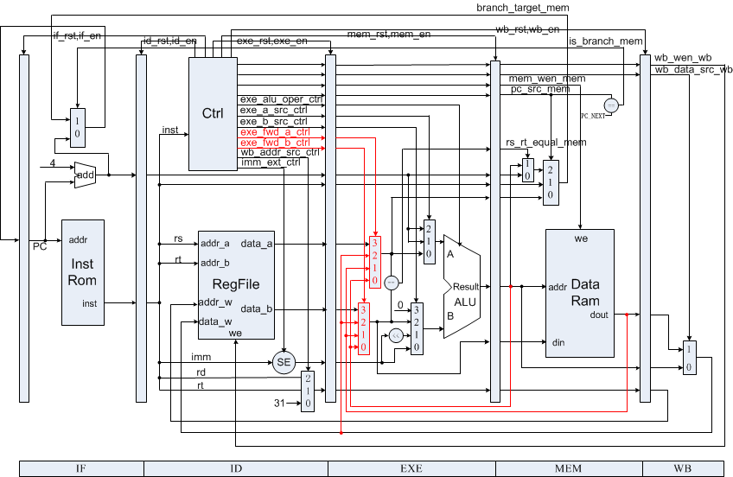
Original Datapath

Slide 15
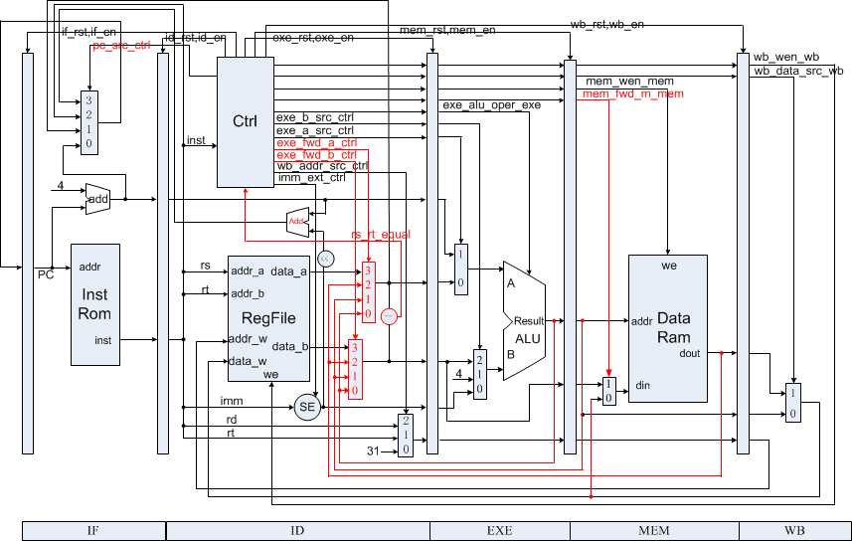
Datapath resolving Control Hazards

Slide 16
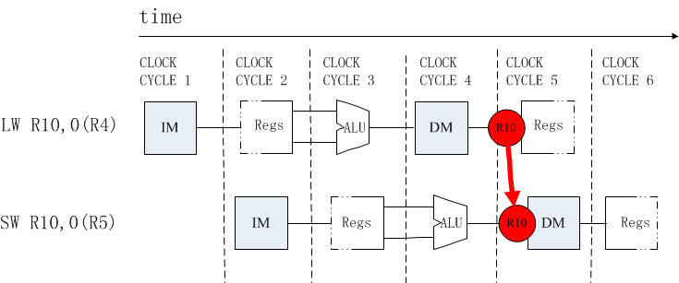
SW After LW/R-Type

Slide 17
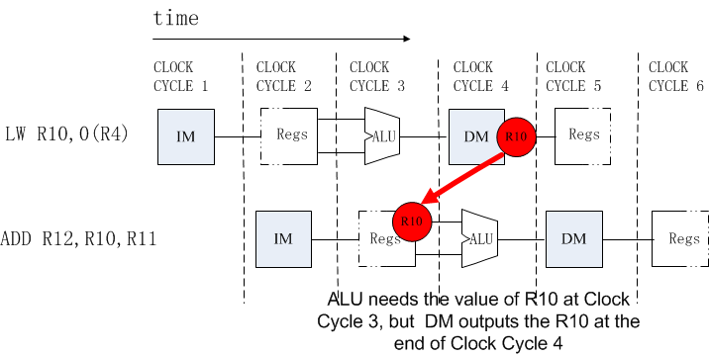
Condition in Which Bypass Unit doesn’t work

Slide 18
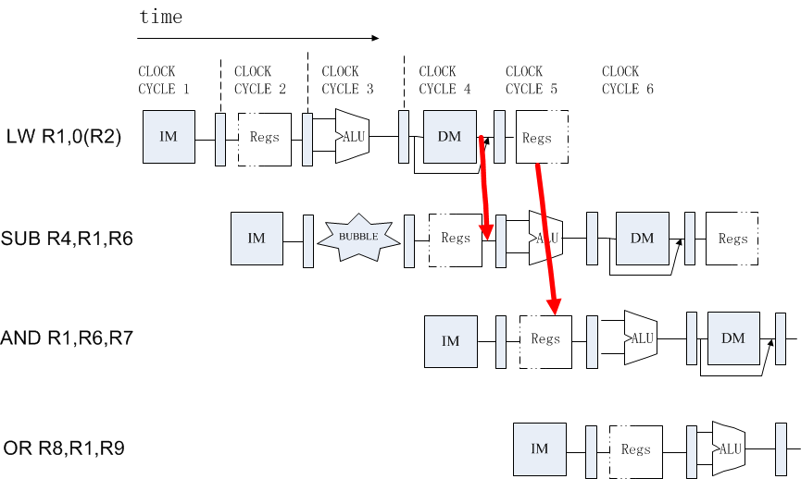
Pipeline stalls at ID Stage

Slide 19
load_stall &&fwd_m in Controller
load_stall = 1
rs_used&& regw_addr_exe == addr_rs &&
wb_wen_exe && is_load_exe
rt_used&&regw_addr_exe == addr_rt &&
wb_wen_exe&&is_load_exe&&~is_store
fwd_m = 1
rt_used&&regw_addr_exe == addr_rt &&
wb_wen_exe&&is_load_exe&&is_store

Slide 20
Program for verification (1)
00000824 main: and $1, $0, $0 # address of data[0]
34240050 ori $4, $1, 80 # address of data[0]
0c00000a call: jal sum # call function
20050004 addi $5, $0, 4 # counter
ac820000 return: sw $2, 0($4) # store result
8c890000 lw $9, 0($4) # check sw
ac890004 sw $9, 4($4) # store result again
01244022 sub $8, $9, $4 # sub: $8 <- $9 - $4
08000008 finish: j finish # dead loop
00000000 nop # done

Slide 21
Program for verification (2)
00004020 sum: add $8, $0, $0 # sum function entry
8c890000 loop: lw $9, 0($4) # load data
01094020 add $8, $8, $9 # sum
20a5ffff addi $5, $5, -1 # counter - 1
0005182a slt $3, $0, $5 # finish?
1460fffb bne $3, $0, loop # finish?
20840004 addi $4, $4, 4 # address + 4
03e00008 jr $ra # return
01001025 or $2, $8, $0 # move result to $v0
00000000 nop # done

Slide 22
Checkpoints
CP 1:
Waveform Simulation of the Pipelined CPU with the verification program
CP 2:
FPGA Implementation of the Pipelined CPU with the verification program

Slide 23
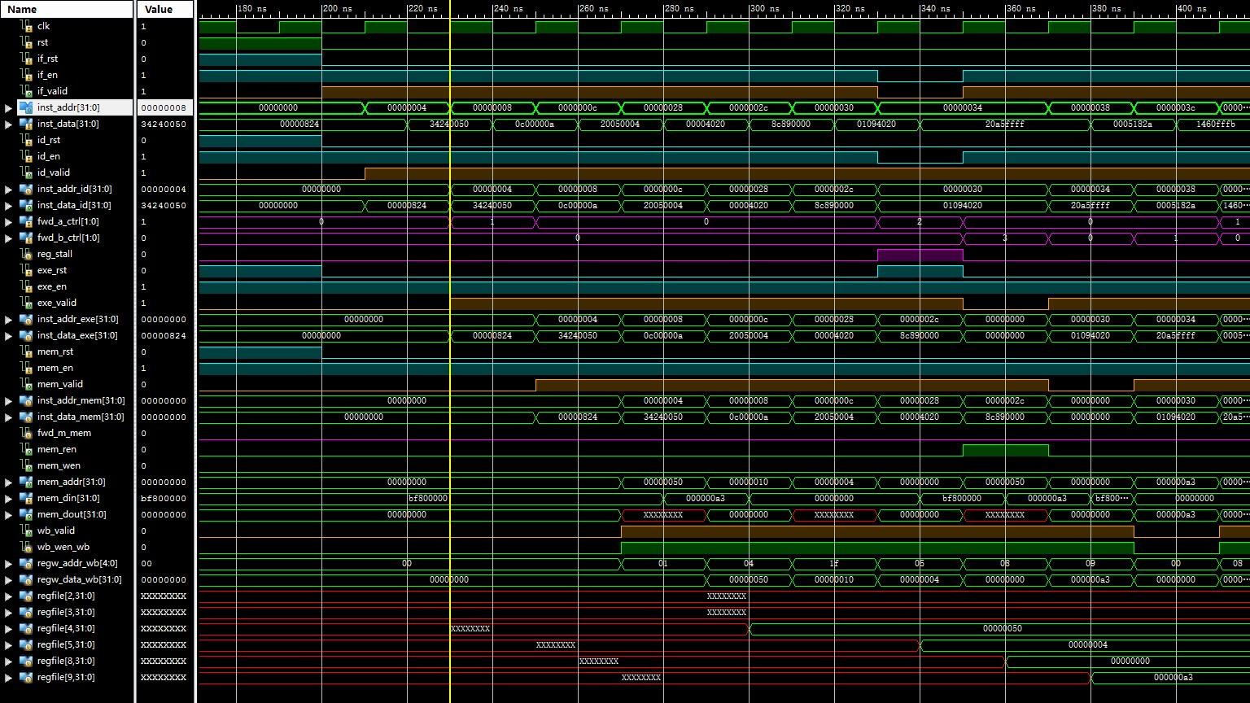
Simulation (1)

Slide 24
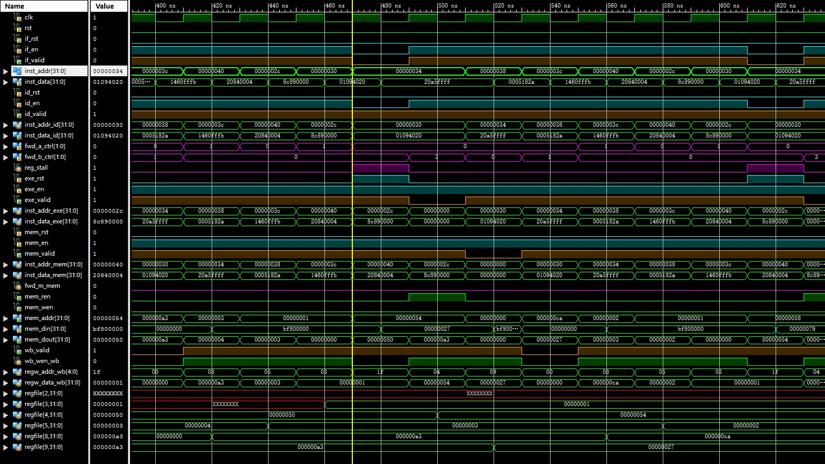
Simulation (2)

Slide 25
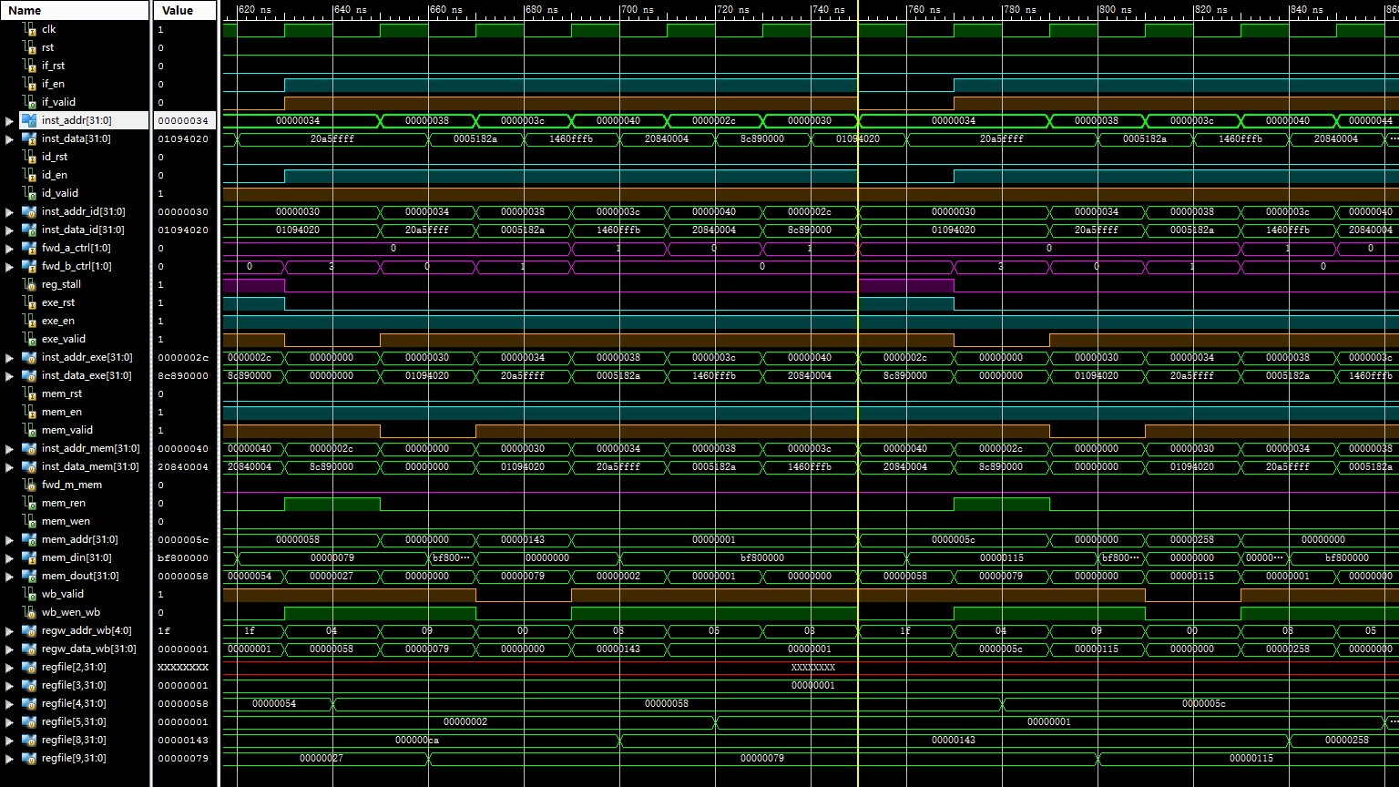
Simulation (3)

Slide 26
Thanks!

